Slide 1


Consumer Goods Ad-Hoc Insights
SQL Project Challenge by
Domain – Consumer Goods
Presenter : Janak Ram

Slide 2
Agenda
01. Introduction
02. Understanding Data
Brief intro about company and business problem they have.
Get to know about database schema and data fields
03. Ad-hoc Requests and Visualization
04. Thank you and Feedback
See how we handle the business issues and convert SQL query output into visualization and create data story from it or discover insights from it.
Expecting feedbacks to improve solutions further.
.

Slide 3

Introduction
Atliq Hardwares (imaginary company) is one of the leading computer hardware producers in India and well expanded in other countries too. However, the management noticed that they do not get enough insights to make quick and smart data-informed decisions. They want to expand their data analytics team by adding several junior data analysts. Tony Sharma, their data analytics director wanted to hire someone who is good at both tech and soft skills. Hence, he decided to conduct a SQL challenge which will help him understand both the skills.

Slide 4
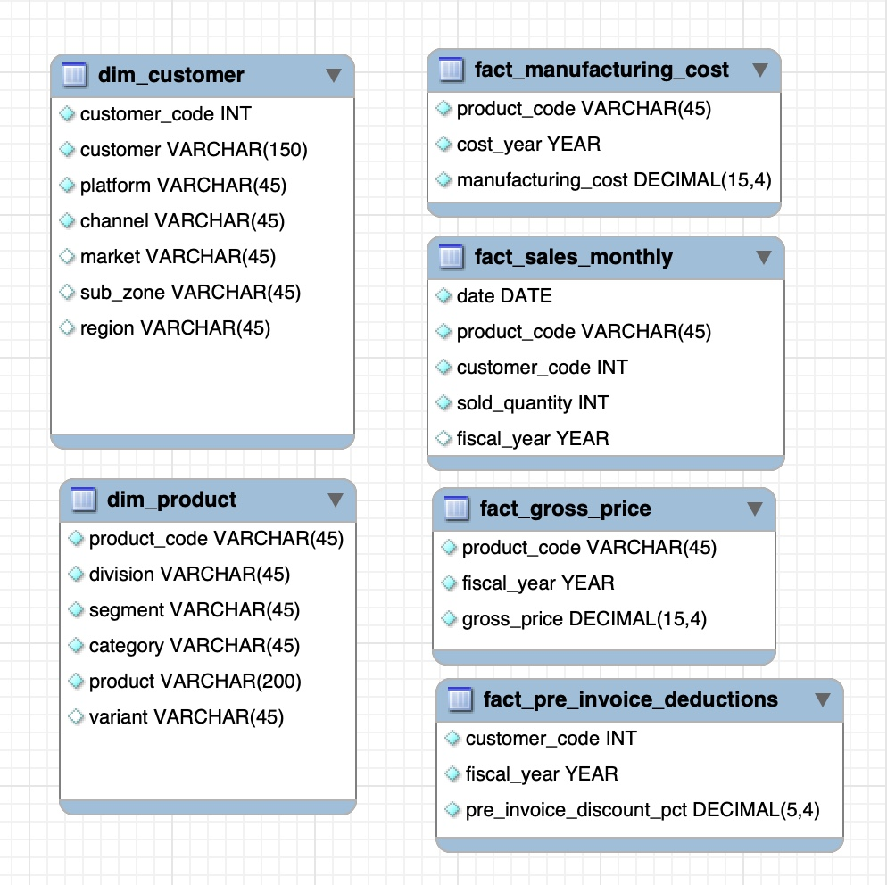
Understanding Data
This database has 6 tables from which two dimensional tables and other ones are fact tables.
The dataset only contains observations for the years 2020 & 2021
DB Table Info:
1. dim_customer: contains customer-related data
2. dim_product: contains product-related data
3. fact_gross_price: contains gross price information for each product
4. fact_manufacturing_cost: contains the cost incurred in the production of each product
5. fact_pre_invoice_deductions: contains pre-invoice deductions information for each product
6. fact_sales_monthly: contains monthly sales data for each product.

Slide 5


Ad-Hoc Analysis

Slide 6
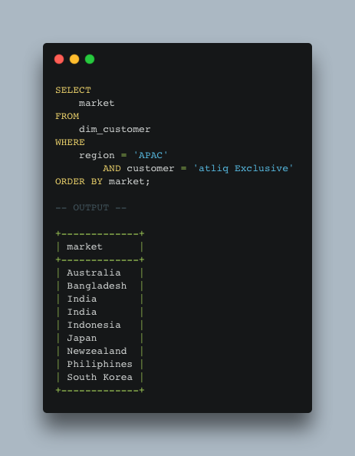
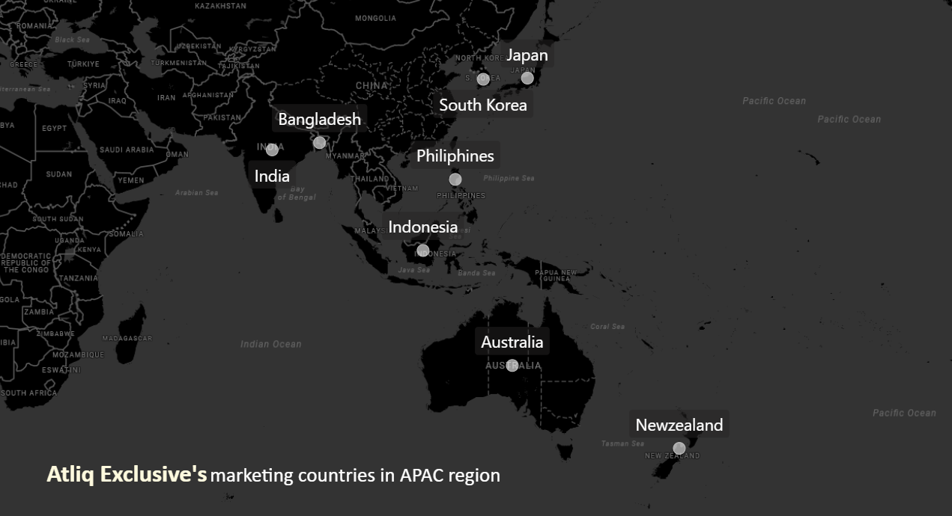
Question 1. Provide the list of markets in which customer "Atliq Exclusive" operates its business in the APAC region.
Key Insights
AltiQ Exclusive is running business in 8 different countries in APAC region

Slide 7
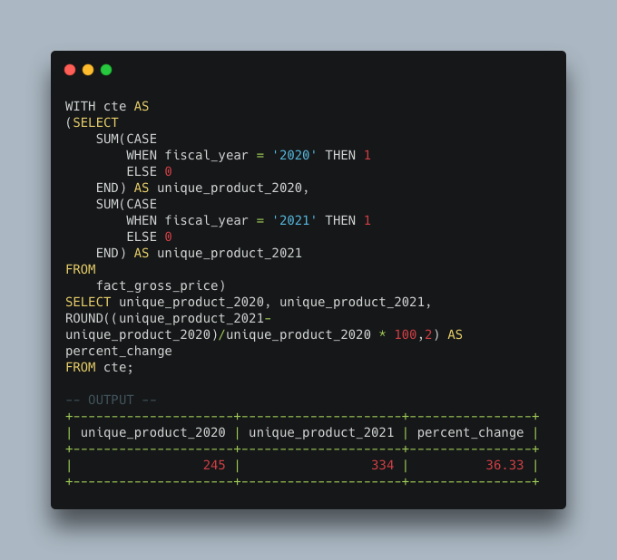
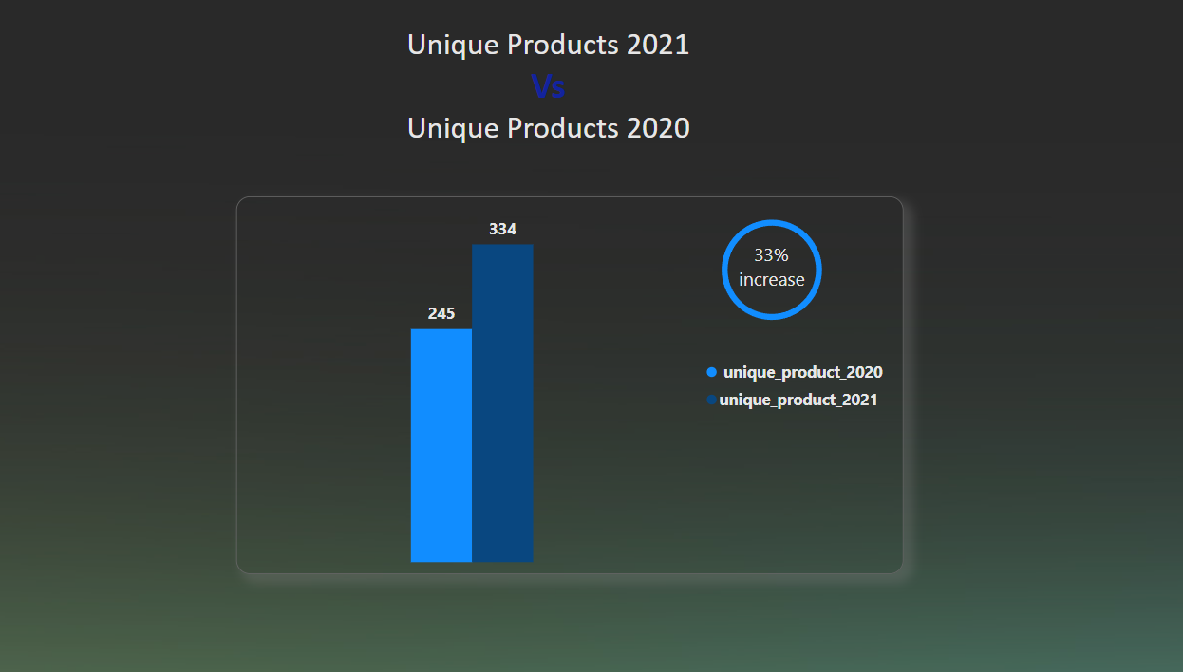
Question 2. What is the percentage of unique product increase in 2021 vs. 2020?
Key Insights
Unique product count is increased by 36.33 %, it clearly shows Atliq Hardware has significant business growth and it continuously investing in new products to align with market and take competitive advantage over other rivals

Slide 8
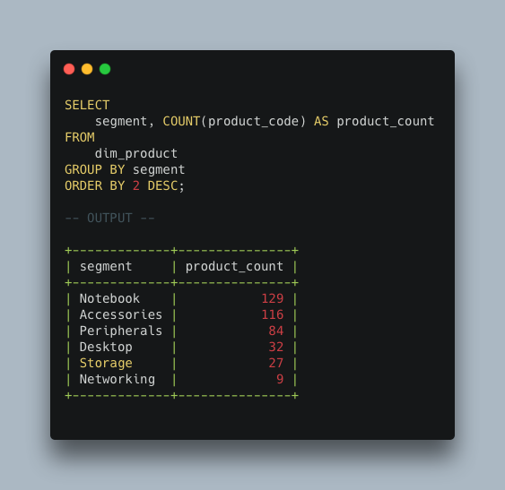
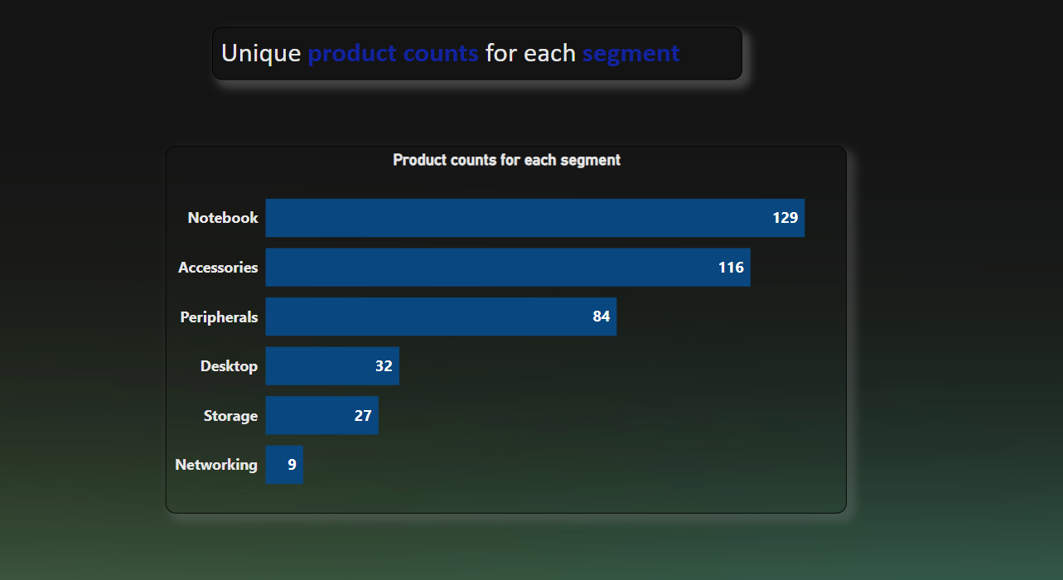
Question 3. Provide a report with all the unique product counts for each segment and sort them in descending order of product counts.
Key Insights
AtliQ Hardware is giving more focus on adding new products mainly in notebook and accessories segment due to high demand. Further, AtliQ might have invested in new segment in networking segment foreseeing IoT demand.

Slide 9
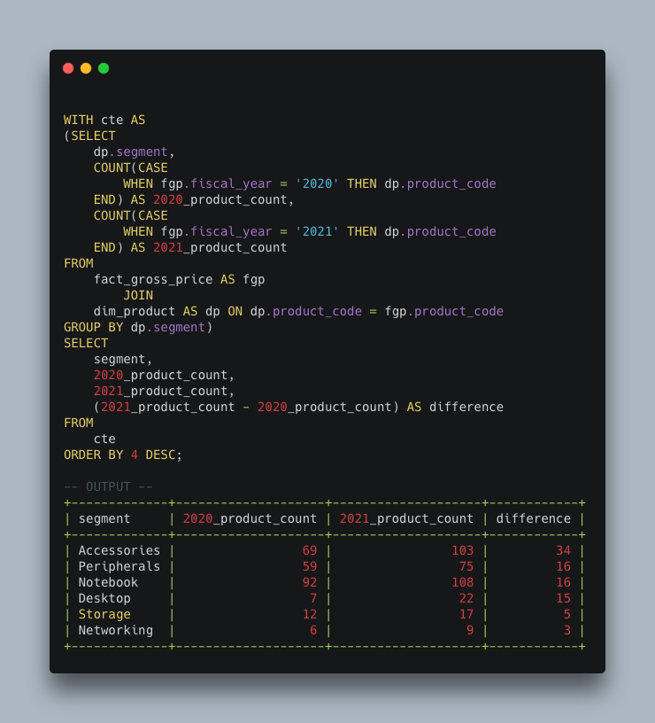
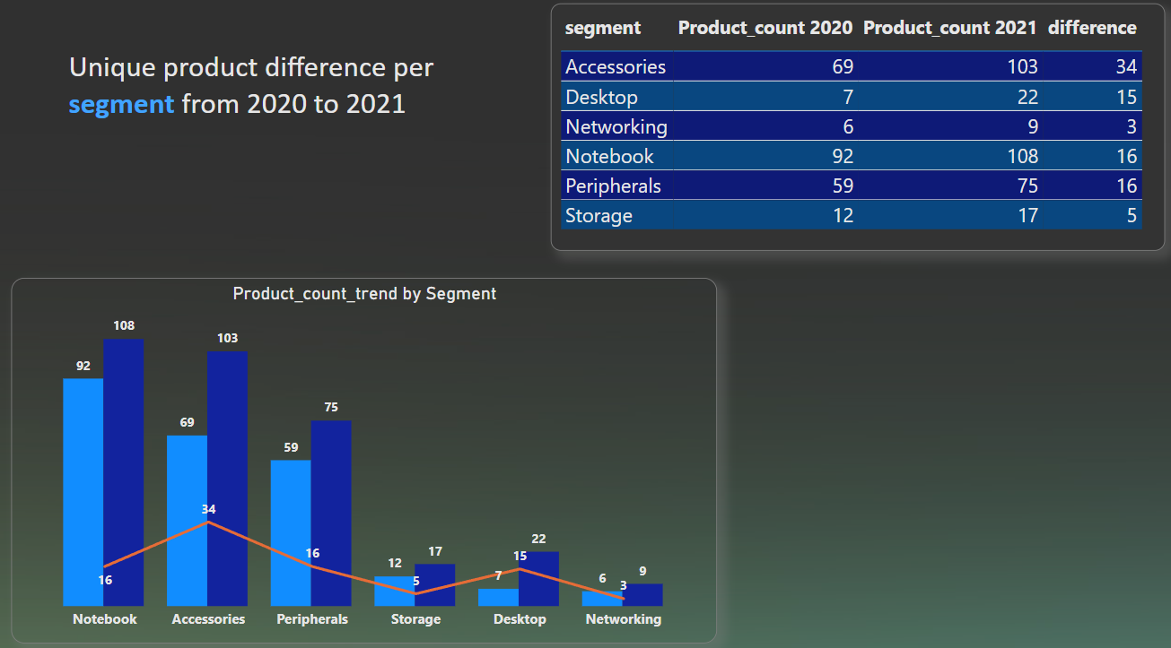
Question 4. Follow-up: Which segment had the most increase in unique products in 2021 vs 2020?
Key Insights
unique products in accessories segment had its maximum in terms of count while Desktop took its maximum percentage

Slide 10
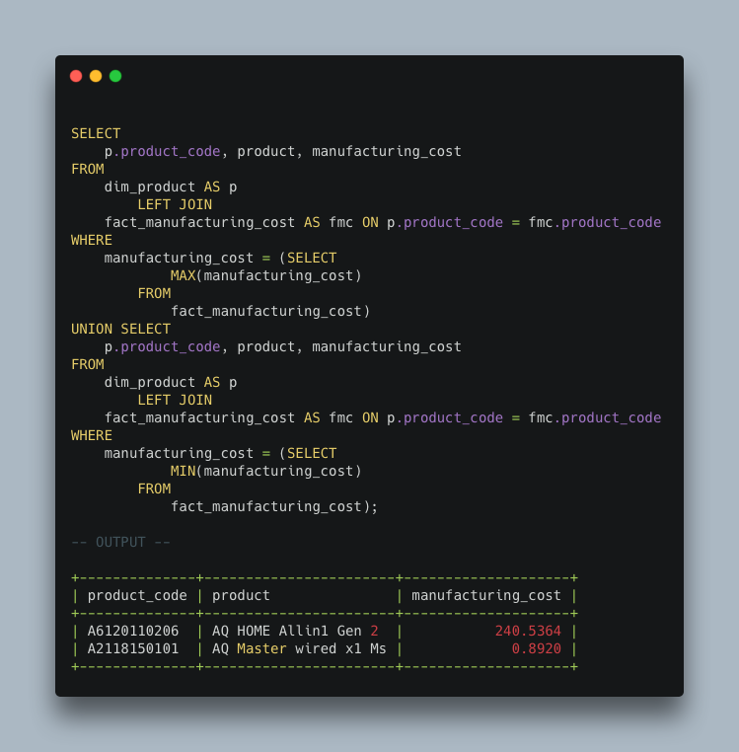
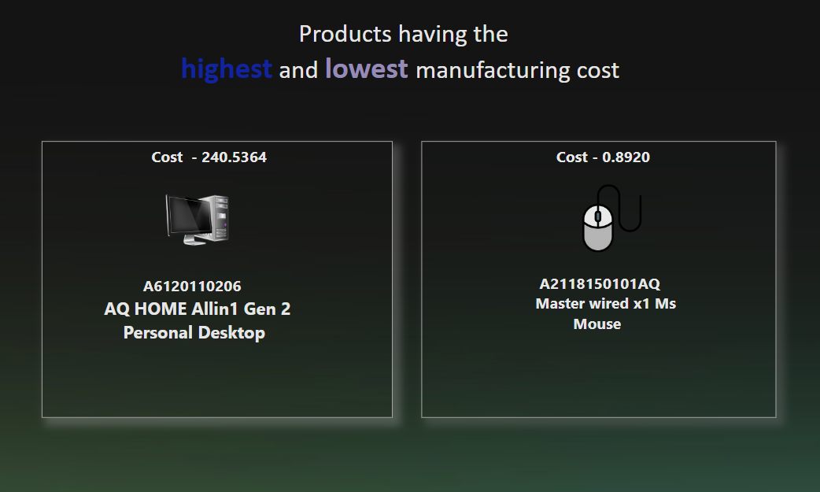
Question 5. Get the products that have the highest and lowest manufacturing costs.
Key Insights
Highest production cost goes to AQ Home Allin 1 Gen2 and lowest is with AQ Master wired X1 Ms

Slide 11
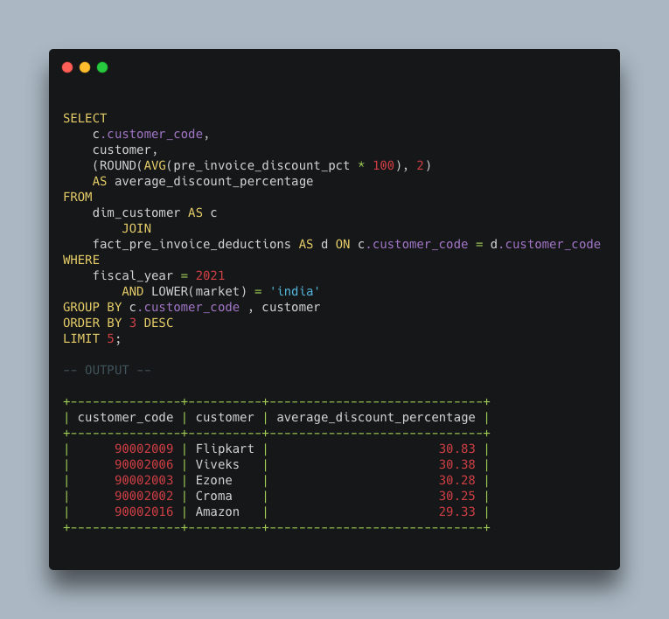
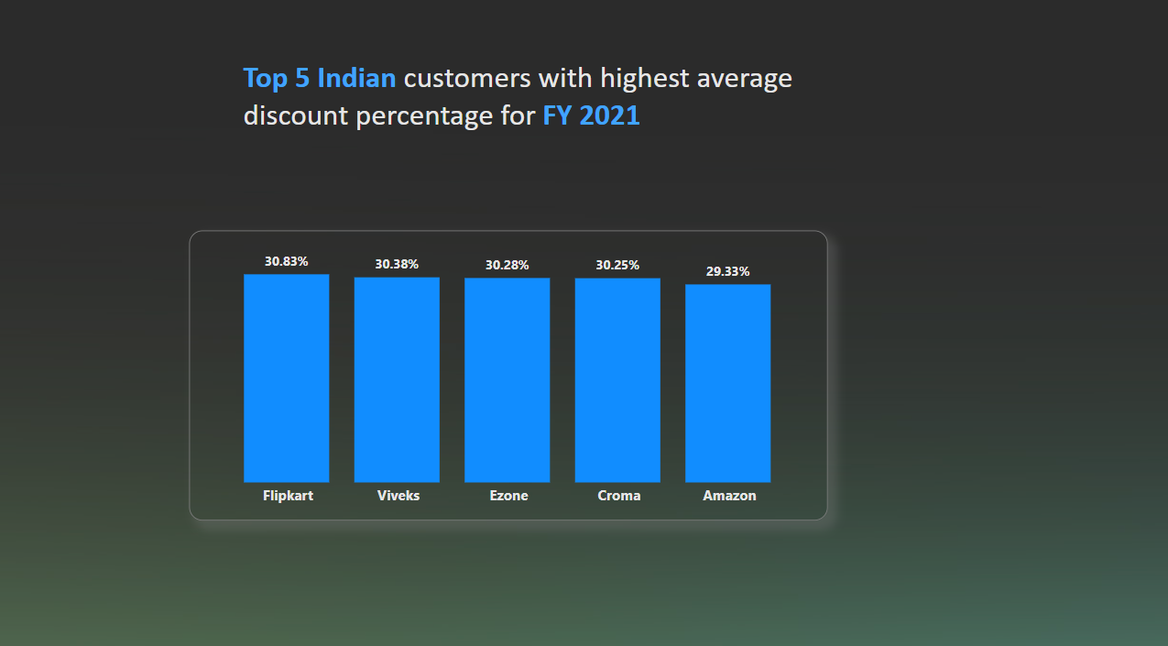
Question 6. Generate a report which contains the top 5 customers who received an average high pre_invoice_discount_pct for the fiscal year 2021 and in the Indian market.
Key Insights
Top 5 customers receives the almost same average 30% of pre-invoice discount percent

Slide 12
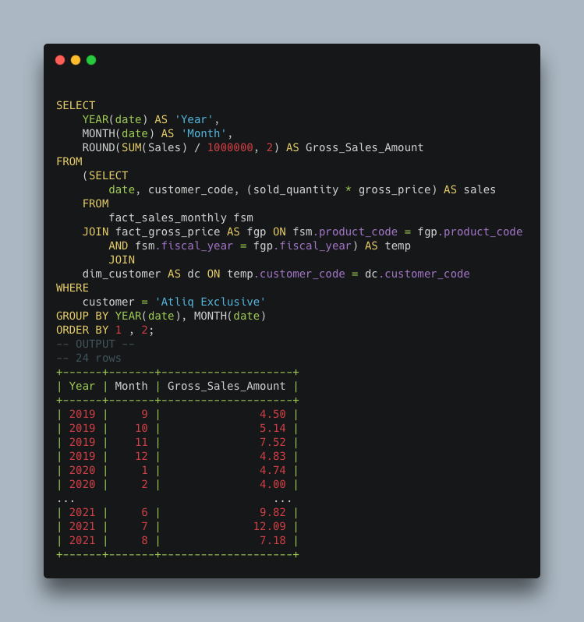
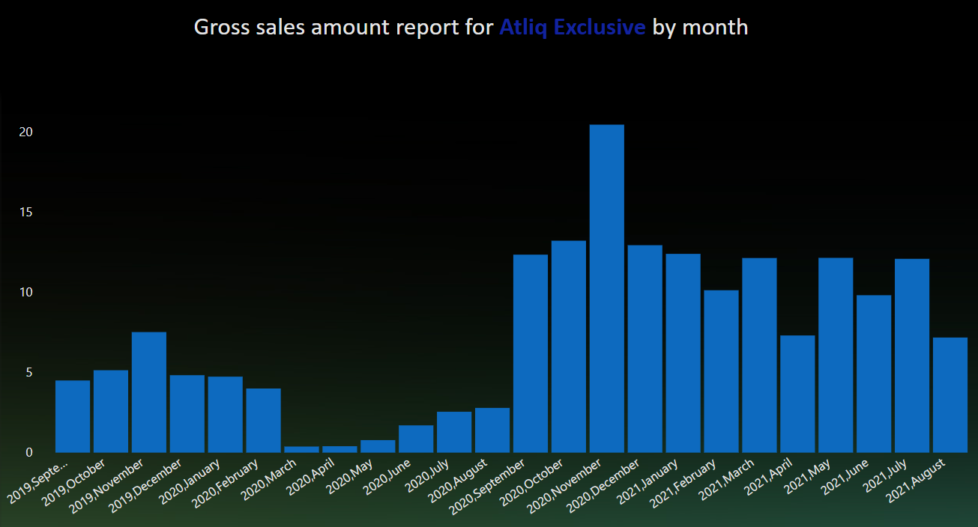
Question 7. Get the complete report of the Gross sales amount for the customer “Atliq Exclusive” for each month .
Key Insights
2020 November shows highest gross sales and from 2020 November , on average more than USD 10 million gross sales were done up to 2021 August. This indicates AtliQ performed well in FY 2021.

Slide 13
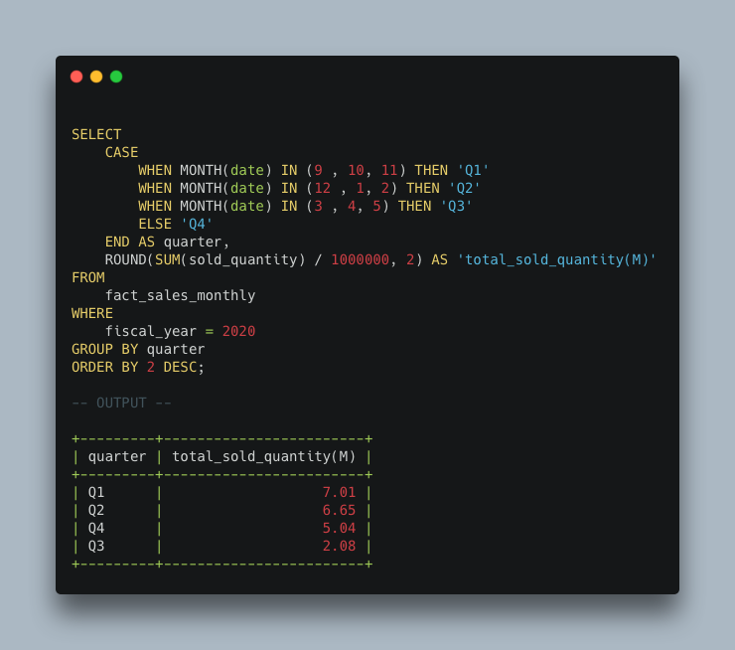
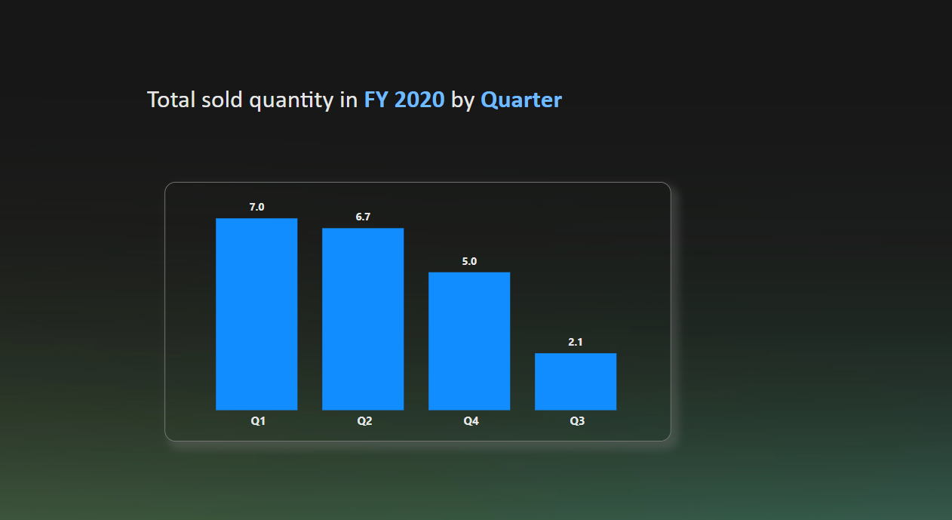
Question 8. In which quarter of 2020, got the maximum total_sold_quantity?
Key Insights
AltiQ Exclusive is outperformed in QI & Q2 compared to other quarters. Christmas & New year holidays could be the reasons sales increase in QI & Q2

Slide 14
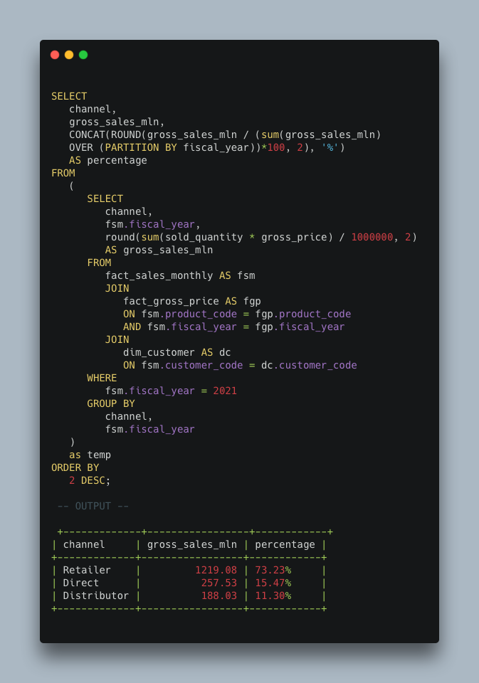
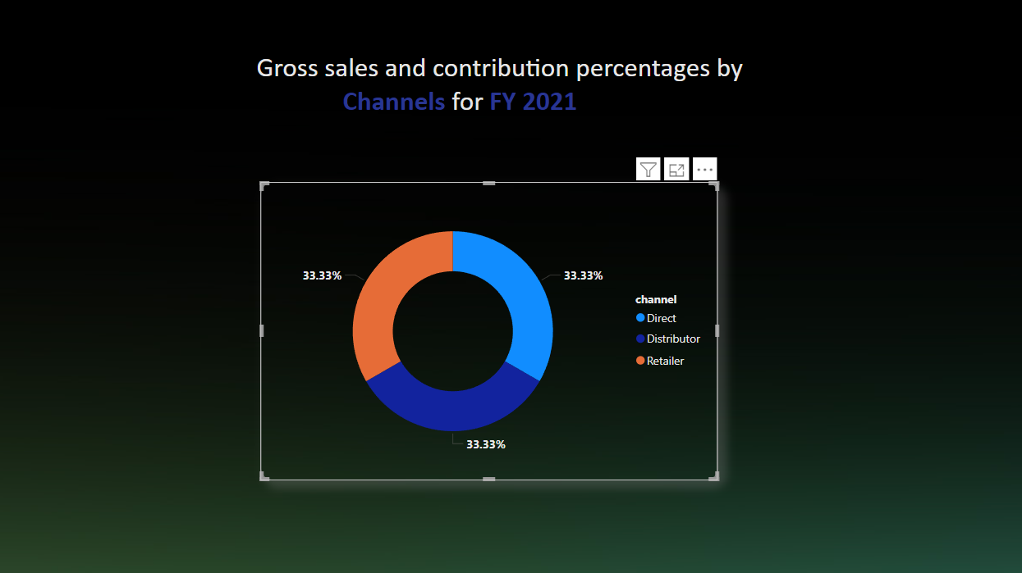
Question 9. Which channel helped to bring more gross sales in the fiscal year 2021 and the percentage of contribution?
Key Insights
Retailer dominates in helping more gross sales for FY2021. AltiQ needs to take strategic moves in other channels to increase sales.

Slide 15
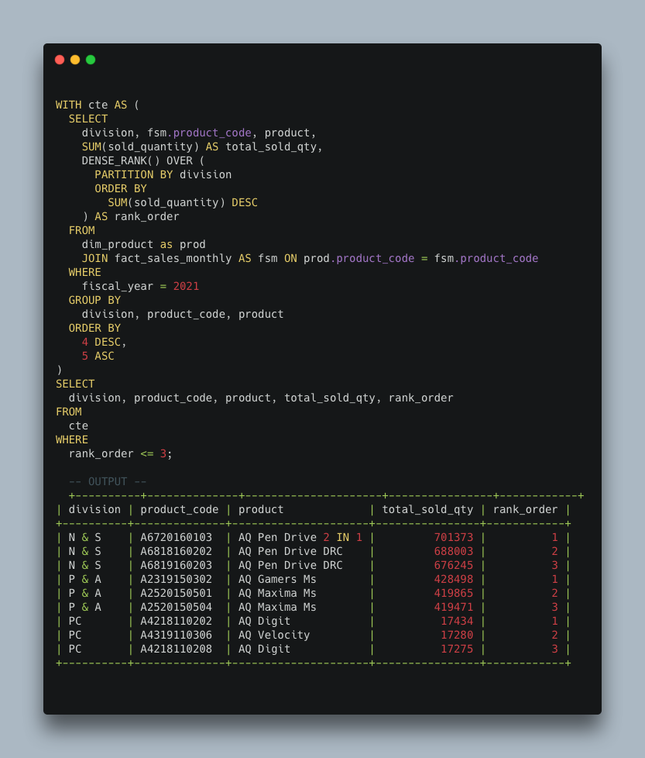
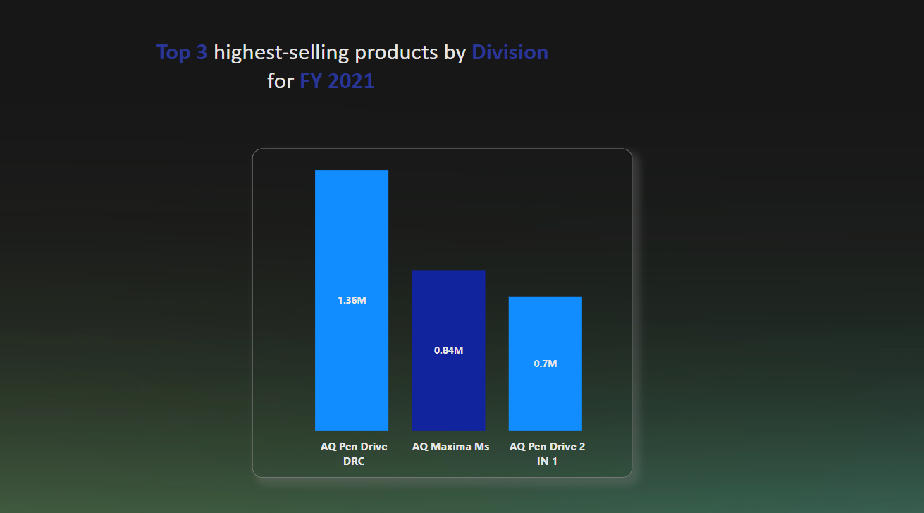
Question 10. Get the Top 3 products in each division that have a high total_sold_quantity in the fiscal_year 2021?
Key Insights
Pen Drive takes number one place in total sold quantity by AtliQ.

Slide 16


Thank you
Thanks to your valuable time and please share your thoughts, suggestion, improvement points in the comments section
www.linkedin.com/in/janak-ram101

